Slide 1
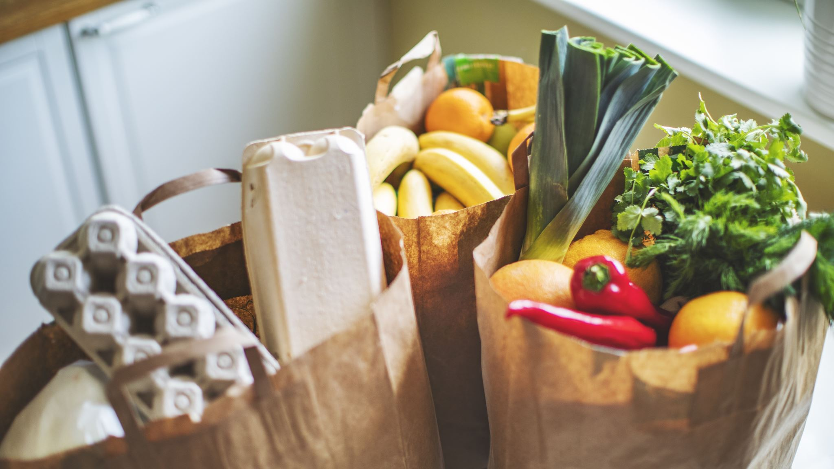
TEAM-4 GROCERY STORE

Slide 2
Venkatesh Devale
Syed Asif
Manoj Dilip
Shreenidhi Bhadra
Lakshmanan Ram
Aishwarya Khonde

Slide 3

AGENDA
Introduction
Business requirements
Problem Statement
Objectives
Implementation
Architecture
Applications
Outcomes

Slide 4
Grocery list application, it's an ecommerce shopping app, which helps the users to shop the groceries online.
Online grocery shopping is a way of buying food and other household necessities using a web-based shopping service.
INTRODUCTION

Slide 5
Users should be able to Login or Sign-Up through login or sign-up page.
Users can be able to add, delete a product from the cart.
Admin should be able to add, update or delete(CRUD Operations) and retrieve a product from the list.
BUSINESS REQUIREMENTS

Slide 6
PROBLEM STATEMENT
Grocery stores or Super-markets are too rush and customers do not bare to stand in the queue for a long time. So, the client decided to have a grocery app to sell his products which will provide benefit to him as well as for the customers too ,by saving their time from standing in the long queues for an hours together at the super-markets , Big-Bazaar etc.

Slide 7
The main objective or goal is to provide an application which is user- friendly, where the user can buy his products and get his products with good quality and in a proper quantity at his/her door step.
The client will earn high profit by selling the products to the customer i.e., increase in customer's repeat purchase will directly increase the rate of profit for the client.
OBJECTIVES

Slide 8
IMPLEMENTATION FOR ADMIN
ADMIN
Can add Grocery
Can delete Unavailable item from Grocery list
Can update a Grocery list

Slide 9
USER
Sign-Up or Login
HOME
List of Categories
Add a Product to Cart
Buy a Product
Payment
IMPLEMENTATION FOR USER

Slide 10
Architecture
Admin
products
ADD
update
delete
Vegetables
Fruits
Dashboard
Groceries
Moves to
cart
User
Meat
Payment
Daily needs
My Orders
Order Successful

Slide 11
Swagger
Java/Java Spring Boot
TOOLS
Git
Maven
AWS
Kubernetes/YAML
Ansible
KAFKA
MYSQL--MongoDB
Docker
Jenkins
Nexus

Slide 12
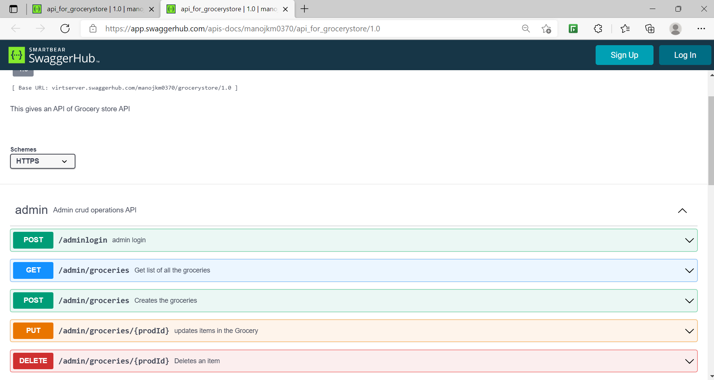
SWAGGER
ADMIN Interface API
Swagger is open-source system, used for format describing REST APIs .

Slide 13
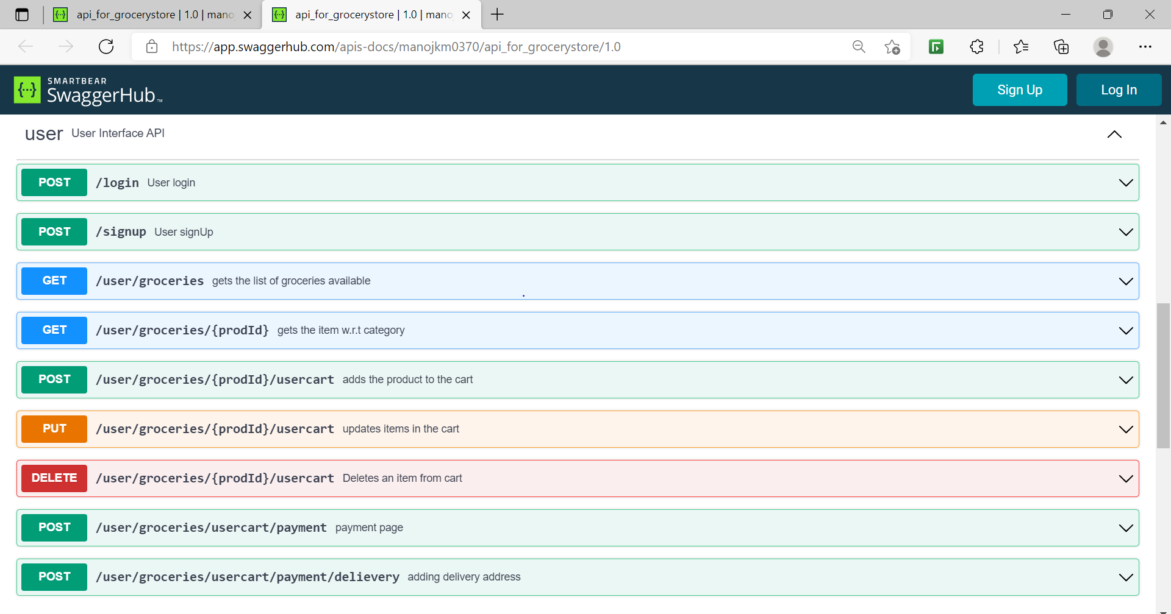
USER Interface API

Slide 14
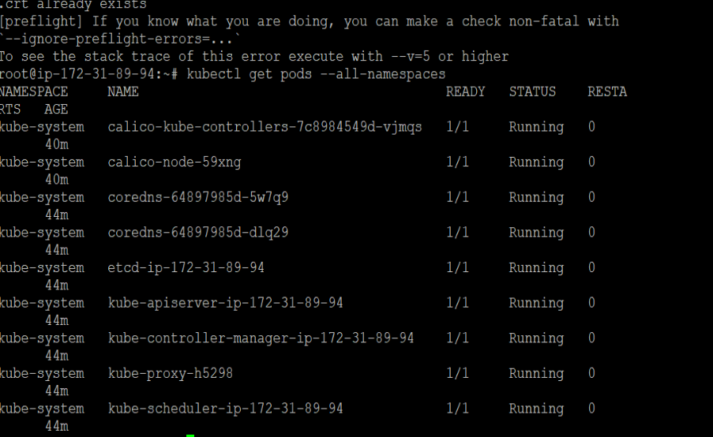
KUBERNETES/YAML
Kubernetes is a open source system used for orchestration or management of containerized applications.
It will show all the pods with namespaces

Slide 15
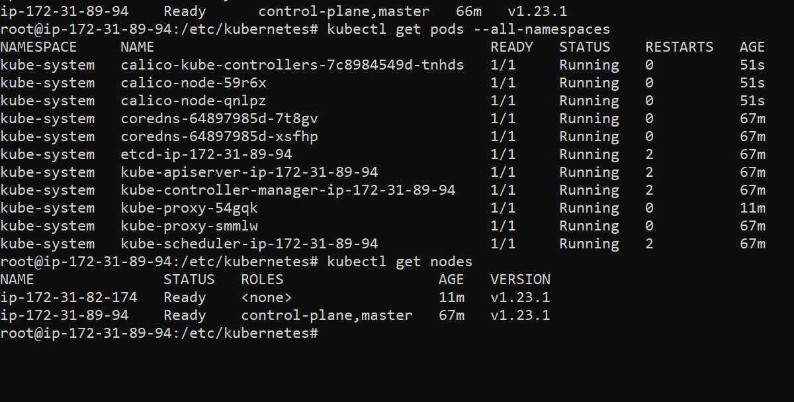
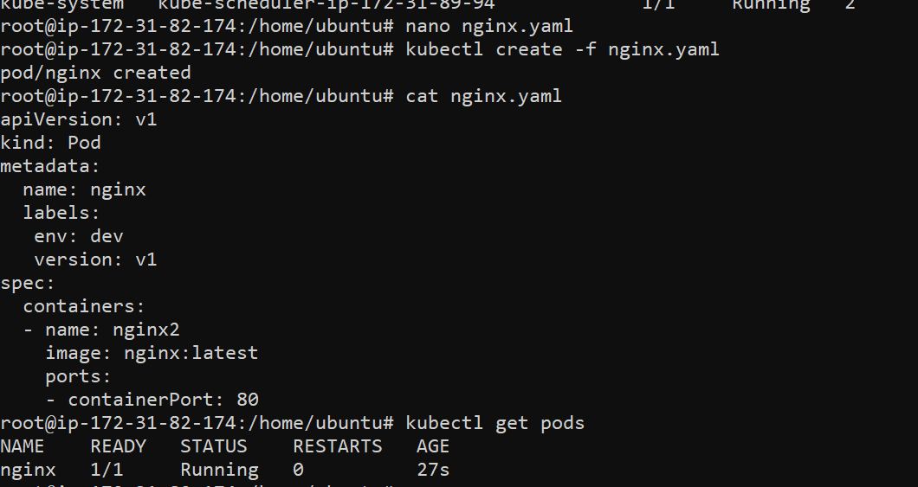
It will show how to create a pod using yaml format
It will show the running nodes

Slide 16
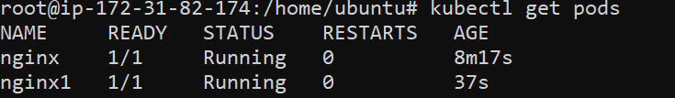
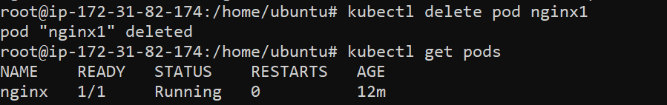
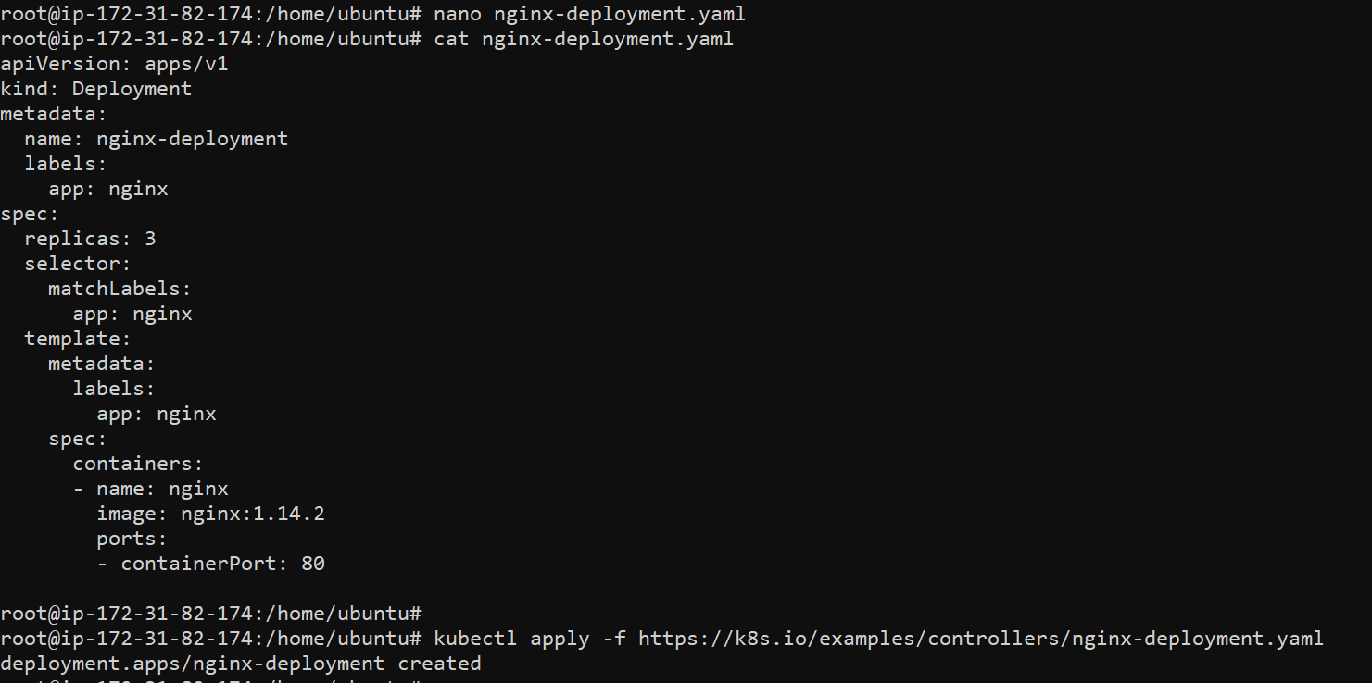
It will show all the running pods
It will display how to delete a pod
DEPLOYMENT
It will show how to create a deployment pod

Slide 17
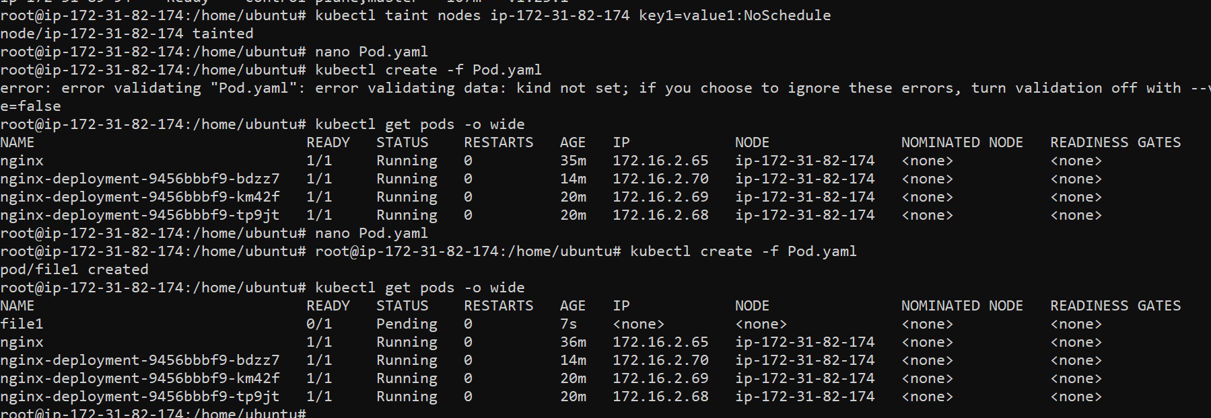
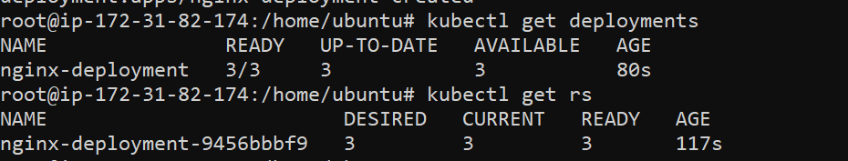
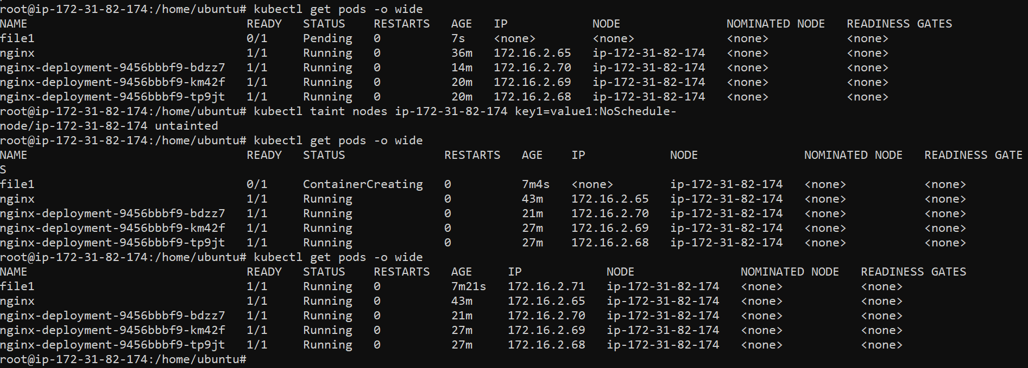
It will show deployment pods
It will show how to taint the node
It will show running pod after untainting the node

Slide 18
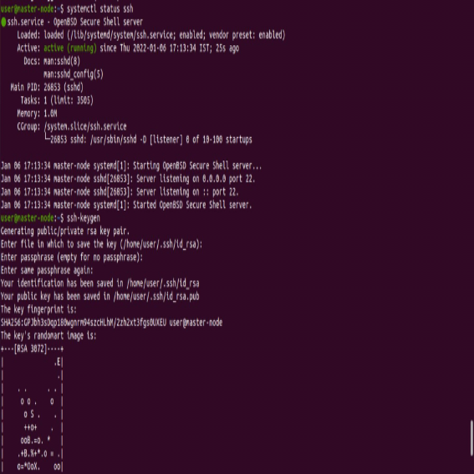
ANSIBLE
Ansible is a open-source ,which automates provisioning, configuration management, application deployment, orchestration and many other IT processes.
ssh-keygen and ssh service

Slide 19
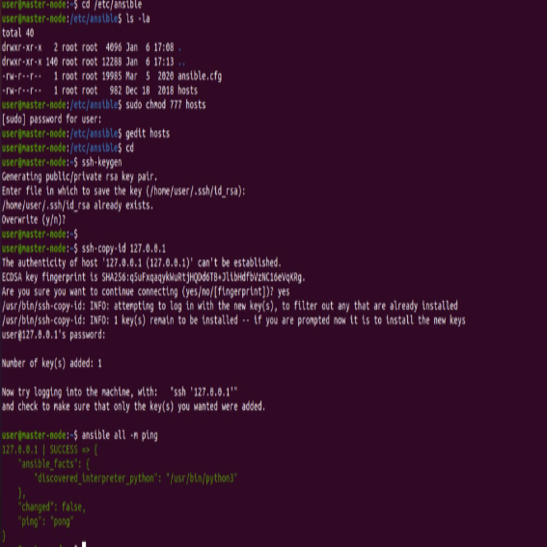
Ip addreess of host machine in hosts of server and listing of host machine

Slide 20
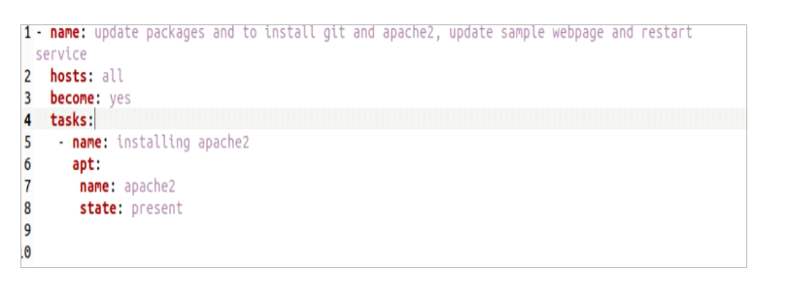
Playbook for installing apache2 in host machine

Slide 21
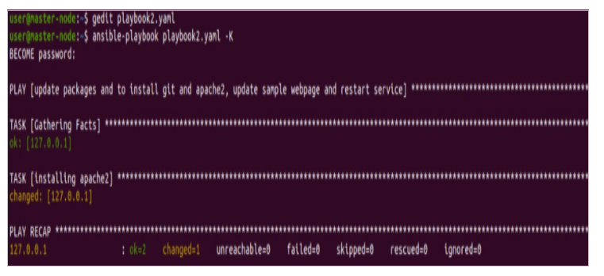
Installation of the apache2 in host Machine

Slide 22
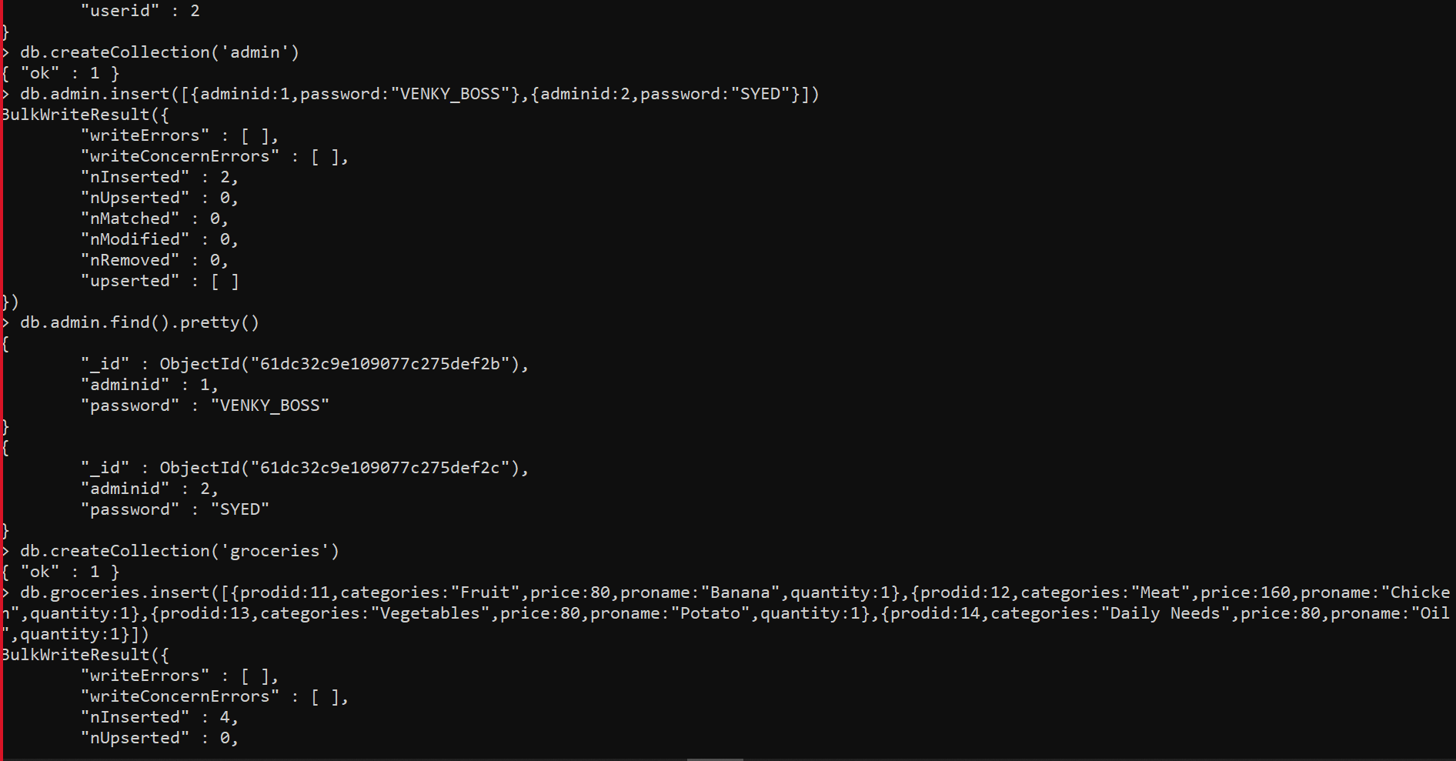
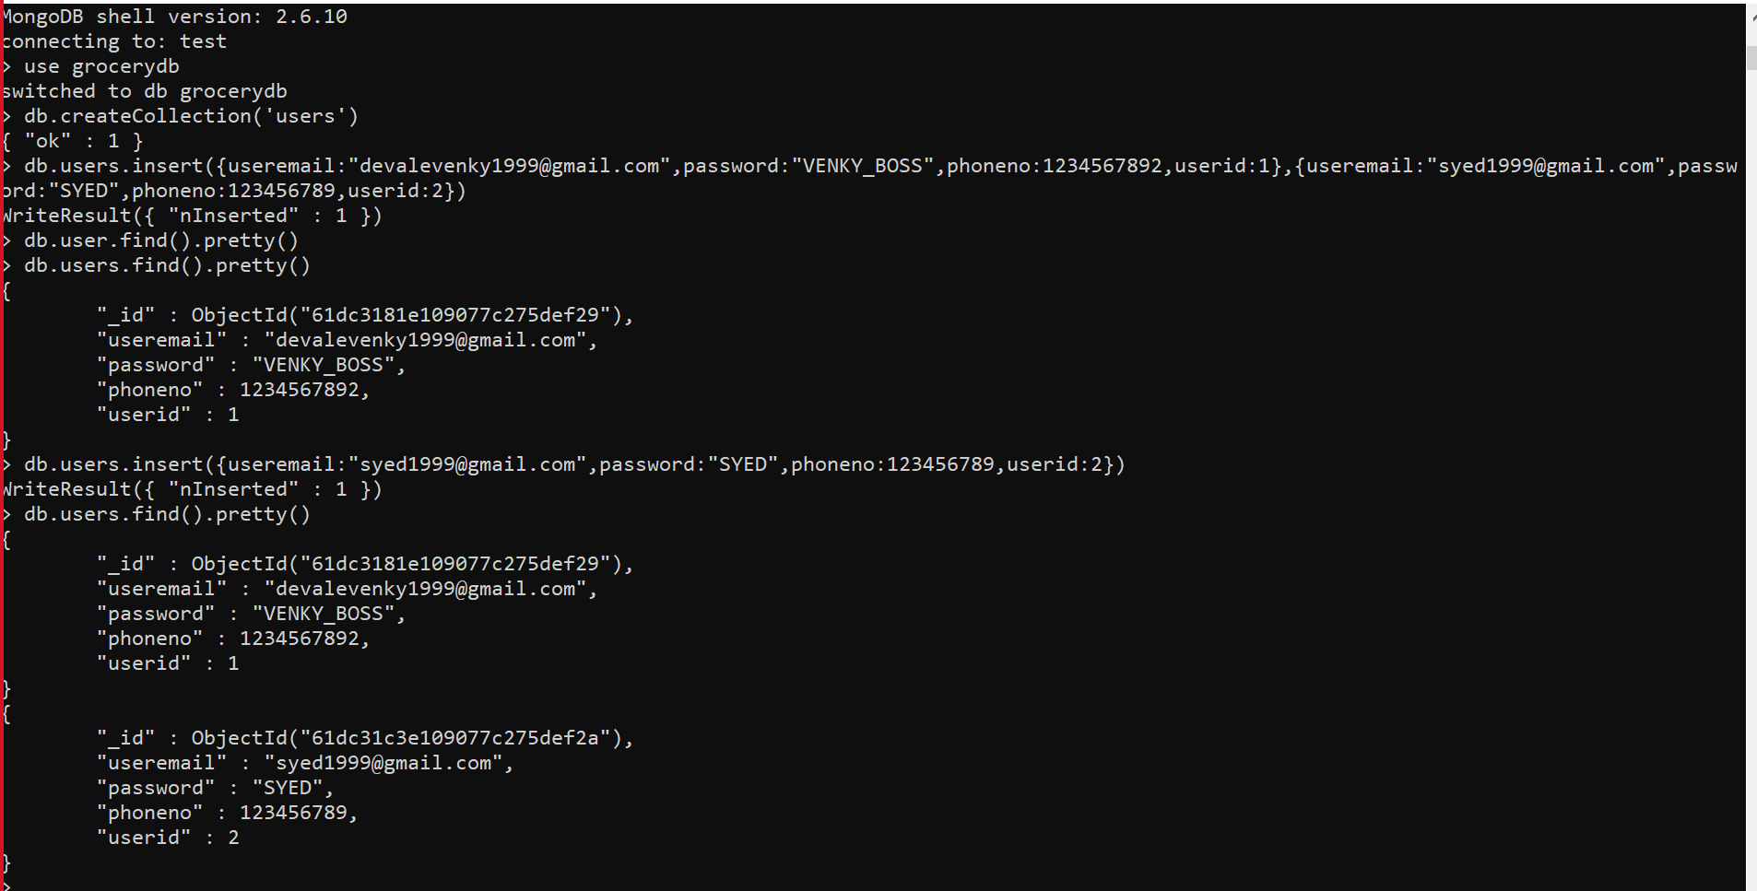
MONGODB
2.Collection for admin
1.It will show how to create a database and create a collection for user

Slide 23
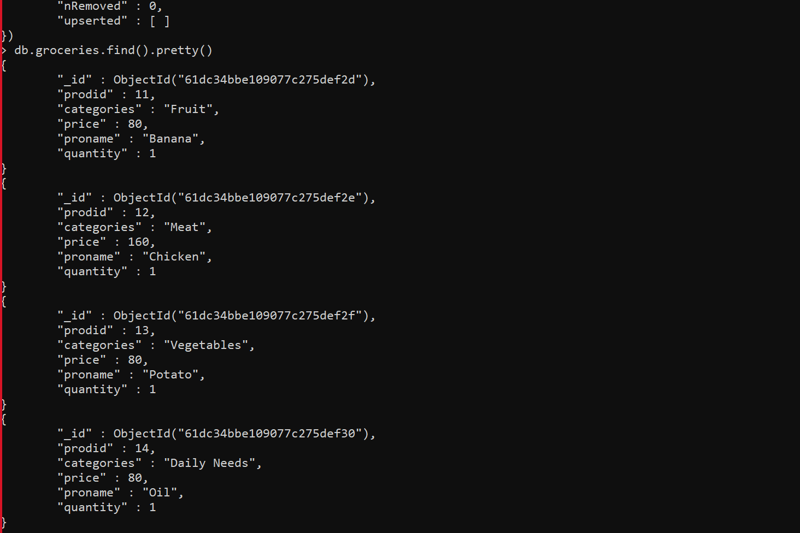
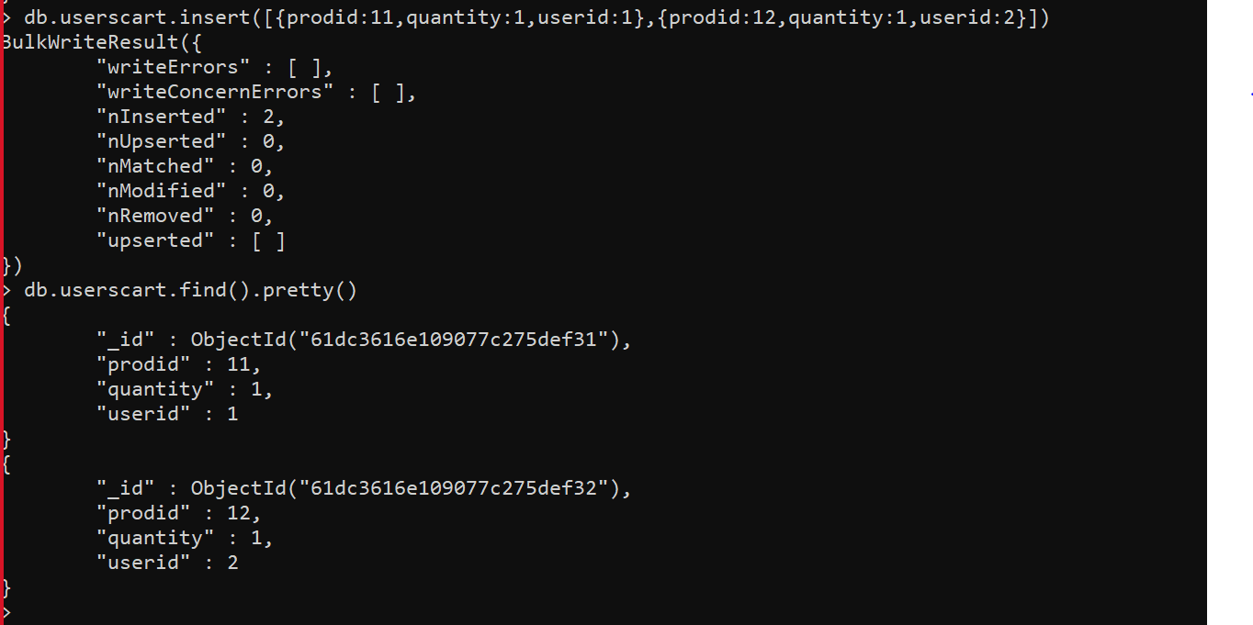
3.It will show collection for groceries
4.Insert command to add the items in collection

Slide 24
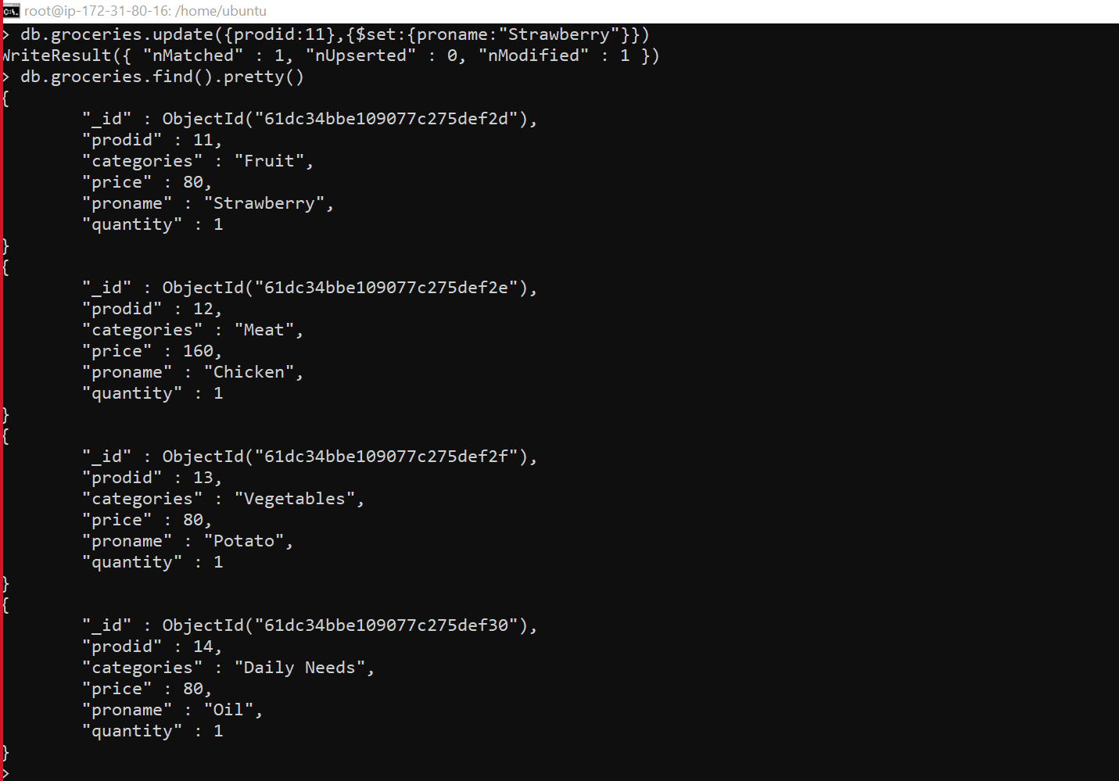
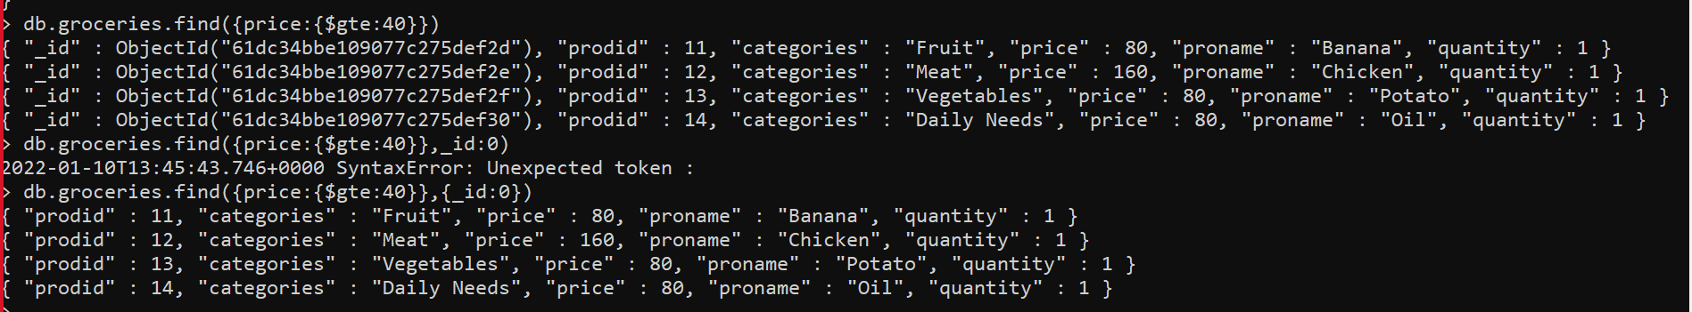
5.Find command to identify the particular item
6.Update query to update the items in collection

Slide 25
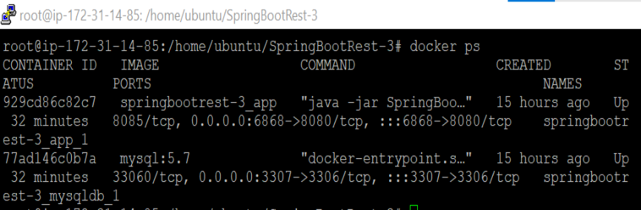
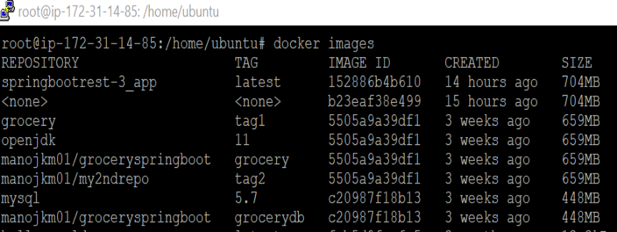
DOCKER
2.Docker containers for grocery list app
1.Docker images for grocery list app's containers

Slide 26
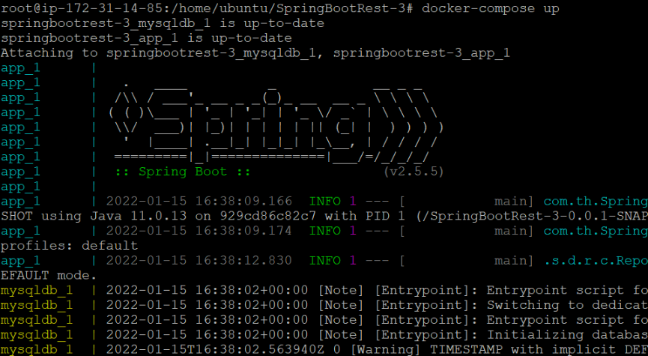
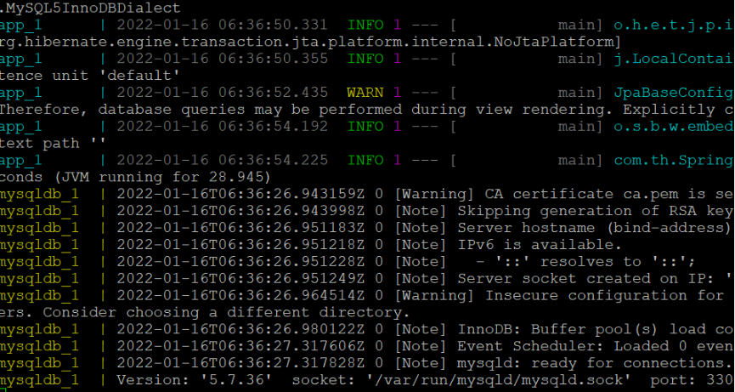
3.Grocery list app running in docker containers

Slide 27
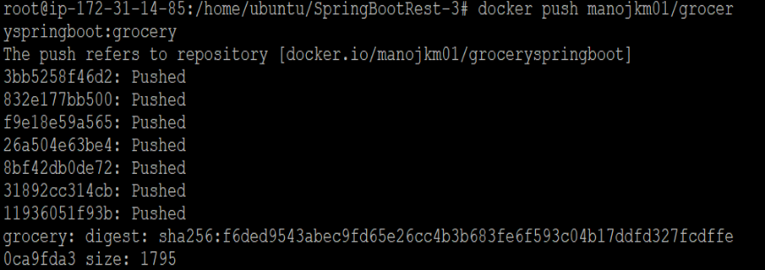
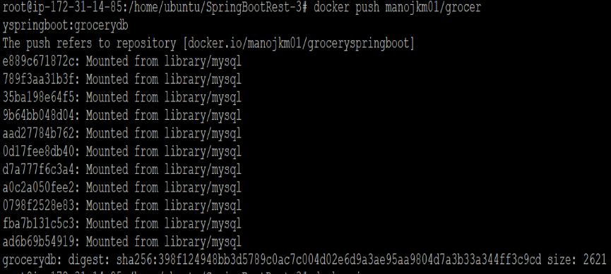
4.Pushing the grocery list app images to the docker-hub repository

Slide 28
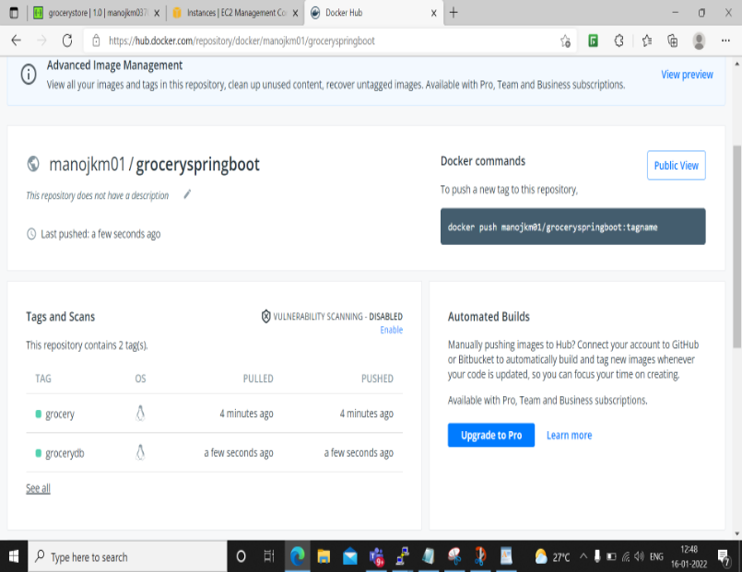
4.Inside docker-hub repo

Slide 29
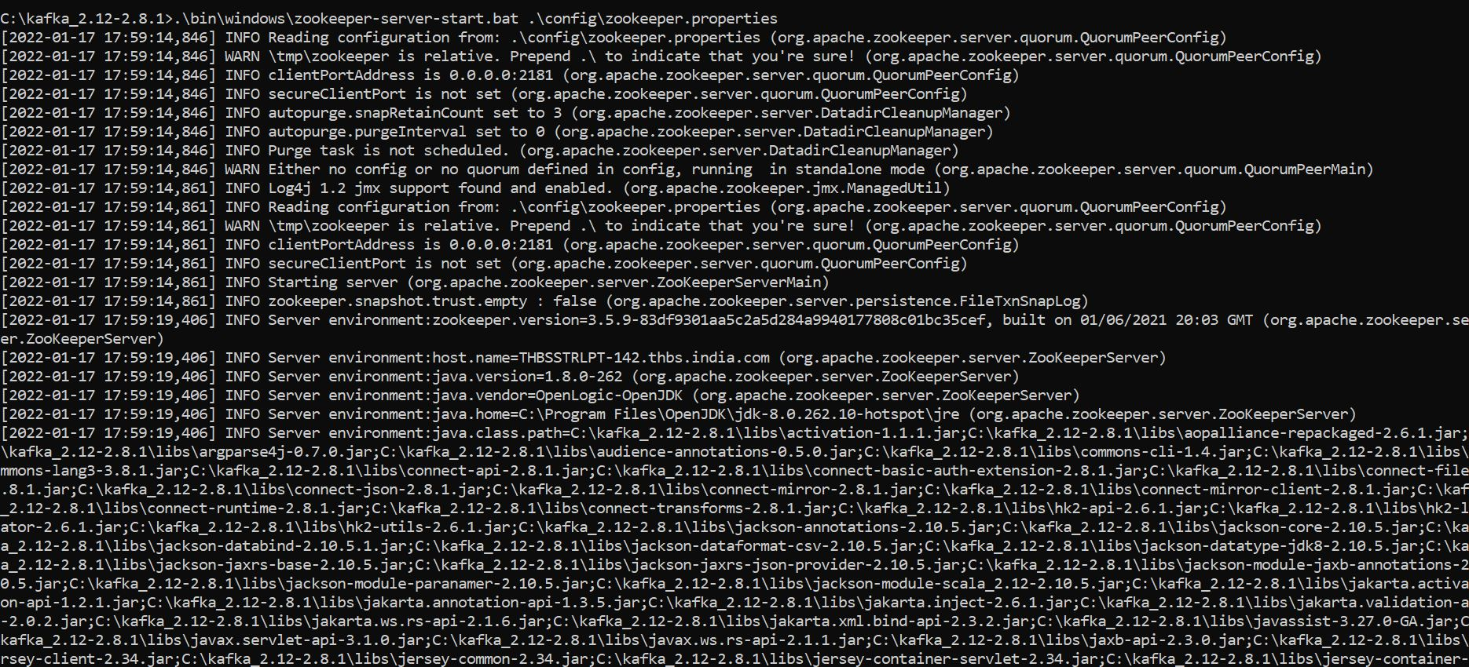
KAFKA
Zoo-Keeper

Slide 30
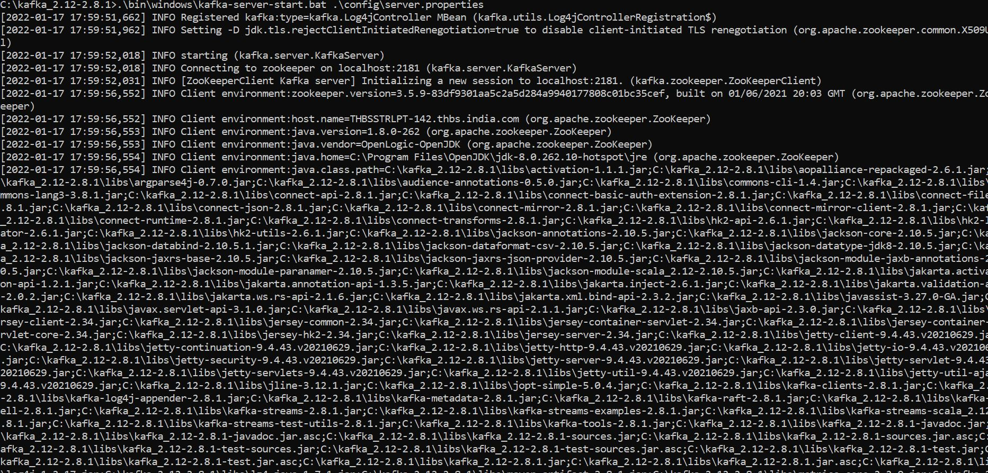
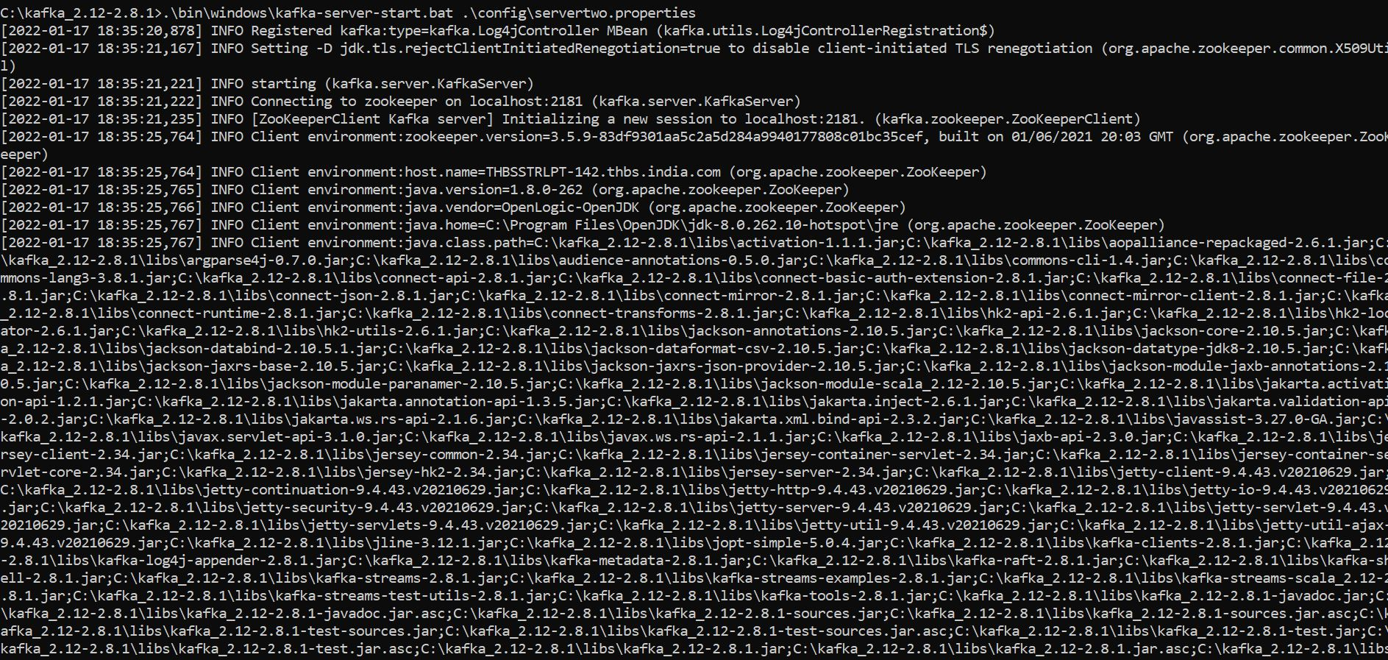
Server1
Server2

Slide 31
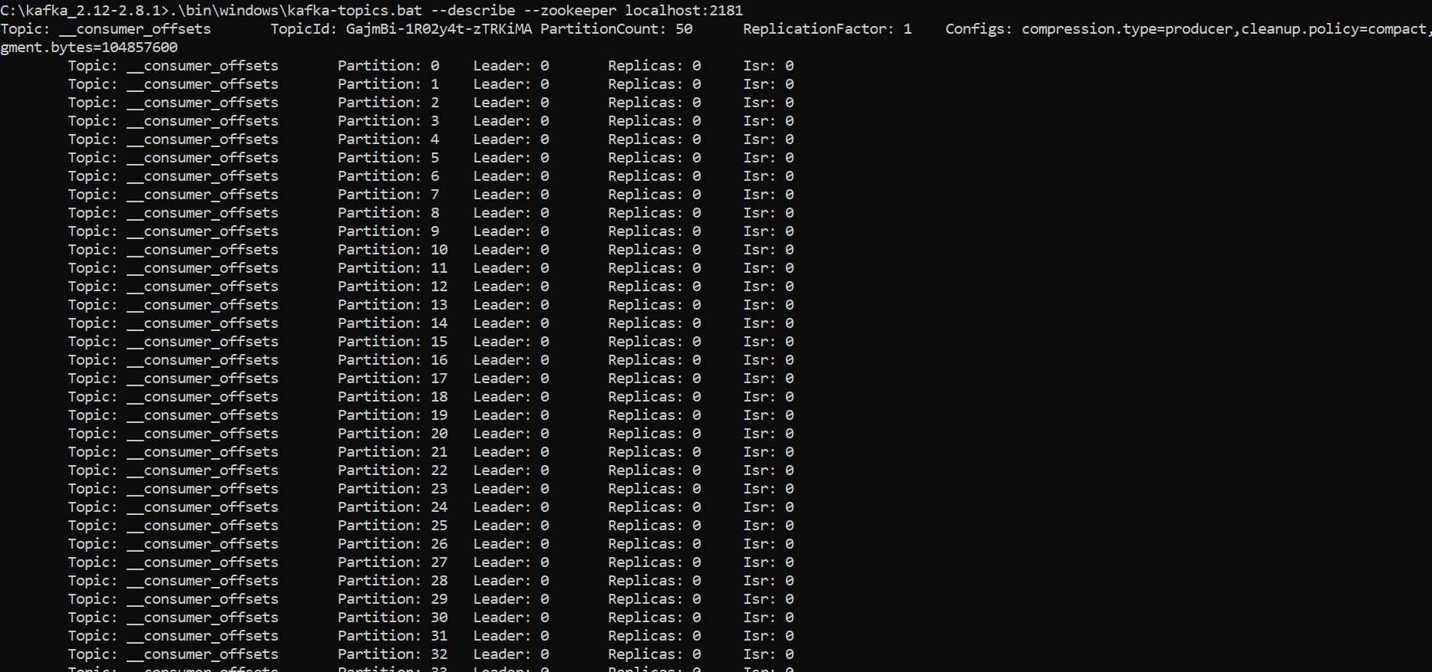
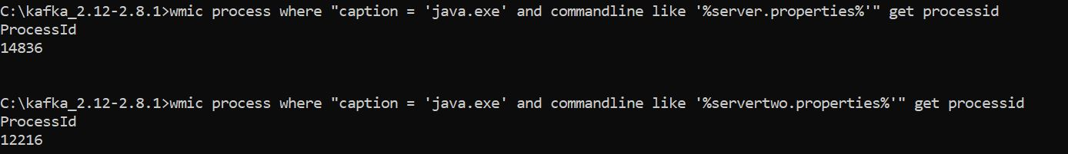
To create a Topic
Multiple Topics
List of Topics

Slide 32
Topic Replication
Producer
Multiple Producer

Slide 33
Consumer
Multiple Consumer

Slide 34
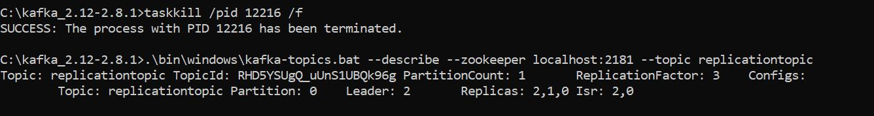
Process Id
Kill and Replicate the topic

Slide 35
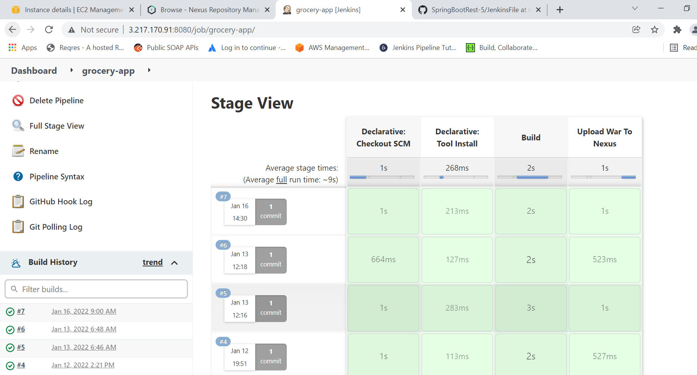
JENKINS
It is an open source system, used to build, test, and deploy the applications.

Slide 36
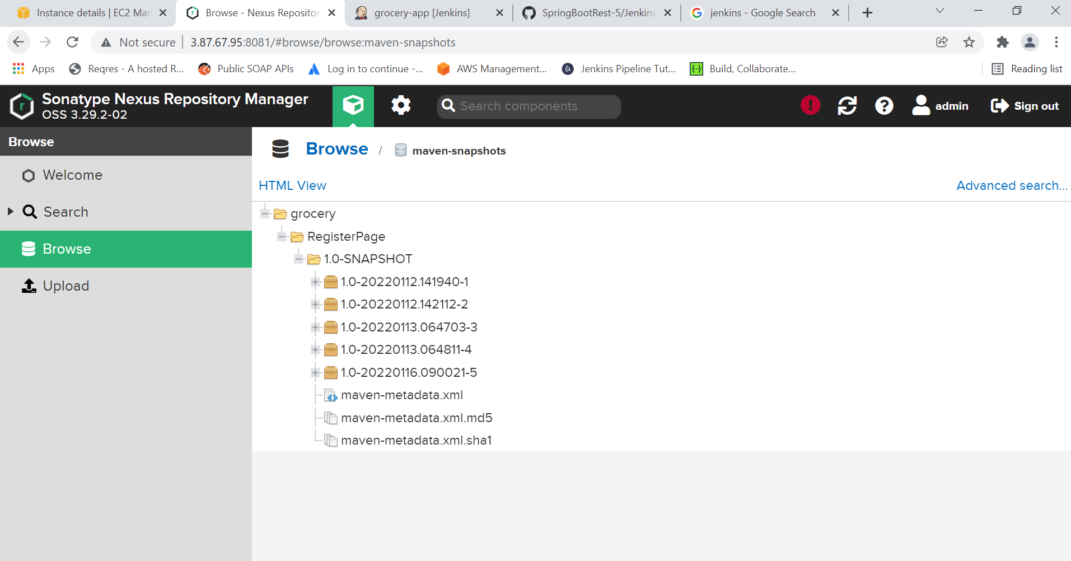
NEXUS
It is a open-source, used for storing the xml or war files.

Slide 37
OUTCOMES
The live Demo will be shown further.

Slide 38
FUTURE IMPLEMENTATIONS
We are hoping to implement Delivery Status (i.e., Ordered, Out for delivery, Delivered).So, that the customer is notified about the delivery of his/her grocery.
Details (like contact) of Delivery Agent.
We can implement the forgot password functionality ,so, that the user can change his/her account password if it is lost or not remembered while logging into the website.
Add extra payment gateways like UPI,net-banking etc

Slide 39
THANK YOU

